Slide 1
Object-oriented Programming
Week 6 | Lecture 1

Slide 2
Inheritance
A form of software reusability where a class inherits an existing class’ behavior and enhances it by adding more functionalities
The existing class is called base class (or sometimes super class) and the new class is referred to as derived class (or sometimes sub class)

Slide 3
Example
The is-a relationship represents inheritance
The car is a vehicle, so any attributes and behaviors of a vehicle are also attributes and behaviors of a car

Slide 4
Inheritance Example
Start with simple class called “Calculator”
In calculator class we have different method.
For example : Addition () , Subtraction() ,
Division () ,Multiplication ()
With the help of object, we can access these behaviors of calculator.
But what if latter we want to create advance calculator or scientific calculator.
One solution is you will edit class calculator but what do you think what should be problem ?
Another solution is you will create AdvanceCalculator() class which has both advance and basic features both but again what do you think is it correct way ? Do we implement same features again and again.
Can we use behavior of class Calculator in advance calculator class this is called “Inheritance” we can easily inherit the property and behavior of other class.
We can easily say this AdvanceCalculator is Calculator.
Class from we can inherit property and behavior of other class is called “Parent class or Super Class ,Base Class and class which inherit properties and behavior is called “Child Class ,Sub Class or Derived Class.

Slide 5
Simple basic class of calculator Example
class Calculator{
public :
int add(int n1,int n2){
return n1+n2;
}
int sub (int n1,int n2){
return n1-n2;
}
}
Int main(){
Calculator obj;
int r1= obj.add(3,4);
// int r2 =obj.sub(4,2);
cout << r1;
}
}
Note : This basic calculator class has only two features. Later another client want to add more two features.

Slide 6
Advance calculator class example
using namespace std;
class BasicCalculator{
public:
int add(int n1,int n2){
return n1+n2;
}
int sub (int n1,int n2){
return n1-n2;
}
};
class AdanceCalculator : public BasicCalculator
{
public:
int multiply(int n1,int n2){
return n1*n2;
}
float division (int n1,int n2){
return n1/n2;
}
};

Slide 7
int main() {
AdanceCalculator obj;
int r1=obj.multiply(3,4);
// int r1= obj.multiply(3,4);
float r2 =obj.division(4,2);
cout<< "The multiplication result is "<< endl << r1 <<"Division result is " <<r2;
// This AdanceCalculator object not only call/access his own class even this object can access feature of BasicCalculator (Base Class) but base class not access feature of Derived class
int r3=obj.add(4,5);
int r4=obj.sub(6,5);
cout << "The Addition result is " << endl << r3 <<"Substraction result is " <<r4;
}

Slide 8
Task
Implement above inheritance code ,then create another class with title VeryAdvanceCalculator Class create method name powerOFTwoNumber(int a,int b) inherit this class from AdvanceCalculator().
Create object of this class then with the help of this object call this method and also method of BasicCalculator class and method of AdvanceCalculator Class with the help of multiple hierarchy of class this is called “Multi level Inheritance” ,when we have just only two classes then this is called “Single Level Inheritence”

Slide 9
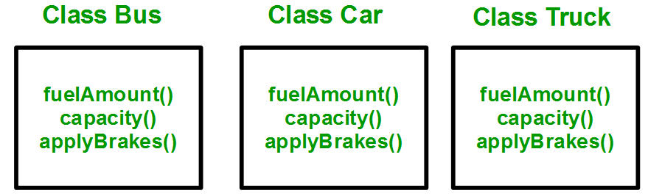
Why and when to use inheritance?
Consider a group of vehicles. You need to create classes for Bus, Car and Truck. The methods fuelAmount(), capacity(), applyBrakes() will be same for all of the three classes.

Slide 10
Why and when to use inheritance?
You can clearly see that above process results in duplication of same code 3 times. This increases the chances of error and data redundancy. To avoid this type of situation, inheritance is used.

Slide 11
Why and when to use inheritance?
If we create a class Vehicle and write these three functions in it and inherit the rest of the classes from the vehicle class, then we can simply avoid the duplication of data and increase re-usability.

Slide 12
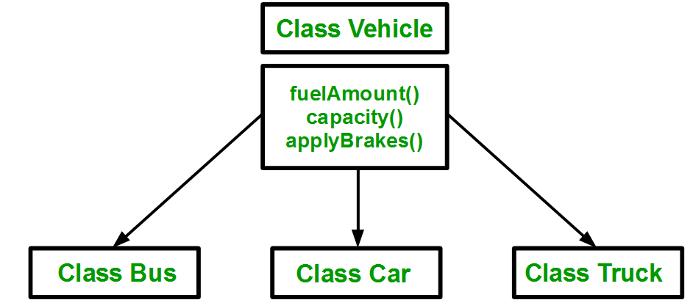
Why and when to use inheritance?

Slide 13
Example
class Vehicle { // data members of base class }
class Car: public Vehicle {
//data members of derived class }

Slide 14
Base & Derived Classes
Every derived-class object is also an object of its base class, and one base class can have many derived classes
A derived class can access all non-private members of its base class

Slide 15
Protected
Protected access modifier is similar to that of private access modifiers, the difference is that the class member declared as Protected are inaccessible outside the class but they can be accessed by any subclass(derived class) of that class.

Slide 16
Protected
#include <iostream>
#include <string>
using namespace std;
class A
{
public:
int xPublic;
protected:
int xProtected;
private:
int xPrivate;
};
int main()
{
A a;
a.xPublic = 0;
a.xProtected = 0; // error: inaccessible
a.xPrivate = 0; // error: inaccessible
}

Slide 17
#include <iostream>
#include <string>
using namespace std;
class A
{
public:
int xPublic;
protected:
int xProtected;
private:
int xPrivate;
};
class B:public A{
public:
B(){
cout << xProtected;
}
};
int main()
{
A a;
B b;
a.xPublic = 0;
// b.xProtected = 0; // error: inaccessible
//a.xPrivate = 0; // error: inaccessible
}

Slide 18
Access Modes in C++ Inheritance
In C++ Inheritance, we can derive a child class from the base class in different access modes.
class Derived : Access Specifier Base {
.... ... ....
};

Slide 19
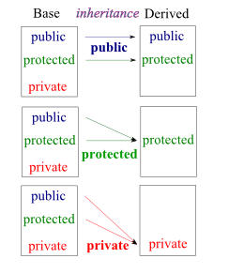
Access Modes in C++ Inheritance

Slide 20
Visibility of Base Class Members
A derived class can use the access modifiers public, protected or private to restrict access to its base class members
In all situations, a derived class can never access private members of its base class

Slide 21
public, protected and private inheritance in C++
public, protected, and private inheritance have the following features:
public inheritance makes public members of the base class public in the derived class, and the protected members of the base class remain protected in the derived class.
protected inheritance makes the public and protected members of the base class protected in the derived class.
private inheritance makes the public and protected members of the base class private in the derived class.

Slide 22
Public Inheritance
The use of access modifier public in derived class header
Example: class myDerived: public myBase
{
// derived class members }

Slide 23
Public Inheritance
In public inheritance:
The public members of a base class are treated as public members of the derived class by other classes further down the hierarchy
The protected members of a base class are treated as protected members of the derived class by other classes further down the hierarchy

Slide 24
Public Inheritance
class GrandChild: public Child
{ // can never access a directly
// can access b directly // can access c directly }
class Parent {
private: int a; public: int b;
protected: int c; }
class Child: public Parent { // can never access a directly // can access b & c directly }

Slide 25
Protected Inheritance
The use of access modifier protected in derived class header
Example: class myDerived: protected myBase
{
// derived class members }

Slide 26
Protected Inheritance
In protected inheritance:
The public members of a base class are treated as protected members of the derived class by other classes further down the hierarchy
The protected members of a base class are treated as protected members of the derived class by other classes further down the hierarchy

Slide 27
Protected Inheritance
class GrandChild: public Child
{ // can never access a directly
// can access b directly // can access c directly }
class Parent {
private: int a; public: int b;
protected: int c; }
class Child: protected Parent { // can never access a directly // can access b & c directly }

Slide 28
Private Inheritance
The use of access modifier private in derived class header
Example: class myDerived: private myBase
{
// derived class members }

Slide 29
Private Inheritance
In private inheritance:
All public & protected members of a base class are treated as private members of the derived class by other classes further down the hierarchy
In other words, these members can be seen as locked and cannot be accessed further down the hierarchy

Slide 30
Private Inheritance
class GrandChild: public Child
{ // can never access a directly
// cannot access b directly // cannot access c directly }
class Parent {
private: int a; public: int b;
protected: int c; }
class Child: private Parent { // can never access a directly // can access b & c directly }

Slide 31
class A
{
public:
int xPublic;
protected:
int xProtected;
private:
int xPrivate;
};
class B : public A
{};
int main()
{
A a;
a.xPublic = 0;
a.xProtected = 0; // error: inaccessible
a.xPrivate = 0; // error: inaccessible
B b;
b.xPublic = 0;
b.xProtected = 0; // error: inaccessible
b.xPrivate = 0; // error: inaccessible
return 0; }

Slide 32
Next Lecture
Types of Inheritance
Function Overloading

